Slide 1
Metaballs and Magic
Turning particles into a fake fluid

Slide 2
What it is
Using the Lorenz attractor particle system, turn the particles into a metaball mesh and give it a water-looking material to look like flowing water (perhaps with white foam and inter-particle physics to splash, making it look more like water). Have a camera follow a smoothed curve representing the average position of the particles as they follow the first, less chaotic cycle, and have it point in the direction of the average velocity of the particles (it follows the system). HDRI of the nohrian opera or something similar, End of All plays. Speed of simulation and other post processing effects determined by intensity of music.

Slide 3
What I hope to learn
Inter-particle physics
Control outside elements based on scripts
Particles programming
TouchDesigner’s metaball system, or how to code my own metaball/isosurface
Shaders in touchdesigner, and stylized water shaders in general
Simulation speed manipulation in TD
HDRIs and Post-processing in td
Camera control in TD

Slide 4
Steps
3d representation of particles
Turn particles into metaballs
Make metaballs visible and decent size
Camera to follow metaballs smoothly
HDRI + Material
Post processing affected by song
Reset button
Speed of sim affected by song
Foam and inter-particle physics
Whatever else makes it better

Slide 5
Go with the Flow
Life from a particle’s perspective

Slide 6
What it is
Using the Lorenz attractor particle system, instance the particles as spheres and give it a water-looking material to look like flowing water. The camera follows an arbitrary particle and points towards the leading particle as they flow. Includes an HDRI and a song, whose volume affects many things like brightness, glare, lens distortion, and the speed of the simulation.

Slide 7
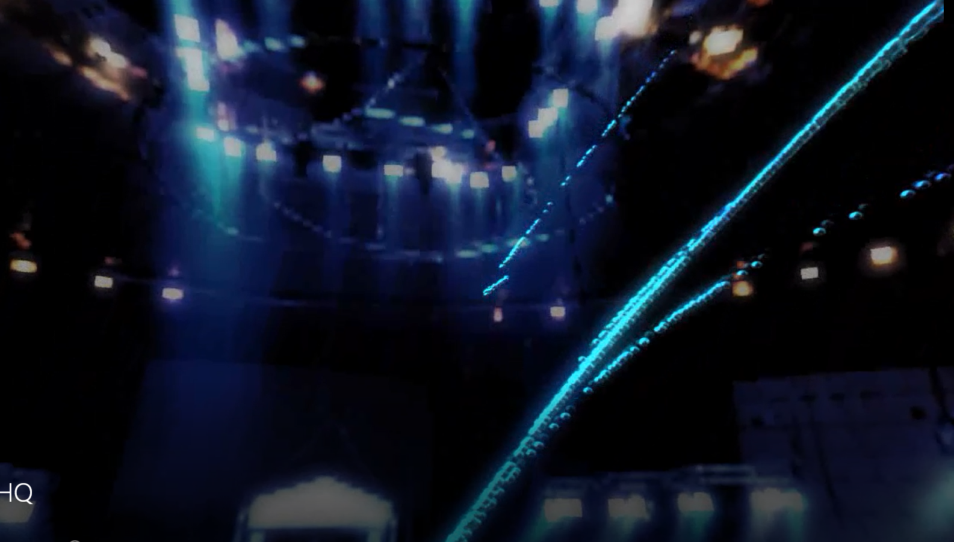
Video Time

Slide 8
github.com/AndrewDunne/CMPM169Projects/tree/main/Proj2

Slide 9
Sources
Music - End of All (Instrumental) by Rei Kondoh
HDRI - Circus Arena 4k from HDRI Haven

Slide 10
Tidbits
Metaballs in Touch have their surface calculated on the CPU, while object instancing is done on the GPU, so no metaball particles :(
If you want your HDRI reflections to appear on objects, you can’t just use an environment light comp: you also need to add an arbitrary light comp.
Spectrum audio viz tutorial
Particle displacement tutorial

